Slide 1
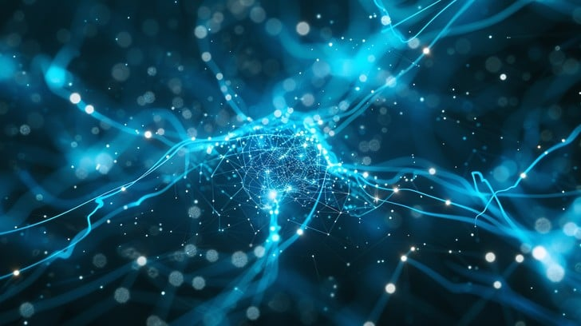
INTELIGJENCA ARTIFICIALE
Introduction to
Artificial Intelligence
Hyrje në Inteligjencën Artificiale
A Journey into the World of Intelligent Machines

Slide 2
PËRMBJATJA / CONTENTS
What We'll Explore
Çfarë do të Eksplorojmë
01
Understanding AI
05
AI in Action
What is AI? History & Daily Applications
Real-World Applications
Kuptimi i IA-së
IA në Veprim
02
Types of AI
06
Benefits & Challenges
Narrow, General & Superintelligence
Advantages & Ethical Concerns
Llojet e IA-së
Përfitimet & Sfida
07
The Future of AI
03
How AI Works
Trends & Predictions
Machine Learning & Neural Networks
E Ardhmja e IA-së
Si funksionon IA
04
Key Technologies
NLP, Computer Vision & Robotics
Let's Begin the Journey!
Teknologjitë Kryesore
Le të Fillojmë Udhëtimin!

Slide 3
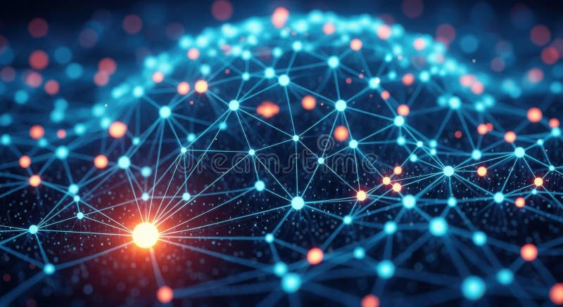
CHAPTER 01
Understanding
AI
Kuptimi i IA-së
What is Artificial Intelligence?
Çfarë është Inteligjenca Artificiale?

Slide 4
01 / UNDERSTANDING AI
What is Artificial Intelligence?
Think of AI as...
Çfarë është Inteligjenca Artificiale?
🗣️ A Virtual Assistant
Asistent Virtual
The Definition / Përkufizimi
🎬 A Recommendation Engine
AI refers to computer systems that can perform tasks that normally require human intelligence. These include recognizing patterns, understanding language, making decisions, and learning from experience.
Motor Rekomandimesh
IA i referohet sistemeve kompjuterike që mund të kryejnë detyra që normalisht kërkojnë inteligjencë njerëzore.
🚗 An Autonomous Driver
Shofer Autonom
🩺 A Medical Diagnostic Tool
Core Capabilities / Kapacitetet Kryesore
Mjet Diagnostikues Mjekësor
Pattern Recognition
Language Understanding
Njohja e Modeleve
Kuptimi i Gjuhës
Decision Making
Learning from Data
"AI is not just about robots—it's about intelligent systems that augment human capabilities."
Marrja e Vendimeve
Të Mësuarit nga të Dhënat
"IA nuk është vetëm për robotë—është për sisteme inteligjente që zgjerojnë kapacitetet njerëzore."

Slide 5
01 / UNDERSTANDING AI
AI in Our Daily Lives
IA në Jetën tonë të Përditshme
You're already using AI every day—here's how! / Ju tashmë po përdorni IA çdo ditë—ja se si!
Smartphone Assistants
Entertainment Recommendations
Email Spam Filters
Siri, Google Assistant, Alexa understand your voice commands, answer questions, and control smart devices.
Netflix, Spotify, YouTube analyze your preferences to suggest movies, music, and videos you'll love.
Gmail, Outlook automatically detect and filter spam emails, learning from your actions.
Asistentët e zërit kuptojnë komandat tuaja dhe kontrollojnë pajisjet.
Platformet analizojnë preferencat tuaja për të sugjeruar përmbajtje.
Filtrat e postës elektronike zbulojnë dhe filtrojnë automatikisht spam.
Navigation Apps
Smart Home Devices
Online Shopping
Google Maps, Waze analyze traffic patterns in real-time to find the fastest routes.
Smart thermostats, lights, security systems learn your habits and adjust automatically.
Amazon, eBay recommend products based on your browsing and purchase history.
Pajisjet inteligjente mësojnë zakonet tuaja dhe rregullohen automatikisht.
Platformat e-commerce rekomandojnë produkte bazuar në historinë tuaj.
Aplikacionet e navigimit analizojnë trafikun në kohë reale.
AI is already everywhere—making your life easier, one interaction at a time!

Slide 6
01 / UNDERSTANDING AI
The History of AI: Key Milestones
Historia e IA-së: Piketat Kryesore
1950
The Turing Test
Alan Turing proposes a test for machine intelligence
Testi i Turingut për inteligjencën e makinës
1956
Birth of AI
Dartmouth Conference coins the term "Artificial Intelligence"
Konferenca e Dartmouth - Lindja e termit IA
1997
Deep Blue Victory
IBM's Deep Blue defeats chess champion Garry Kasparov
Deep Blue fiton kundër Kasparovit
2011
Watson Wins Jeopardy!
IBM Watson demonstrates natural language understanding
Watson fiton në Jeopardy!
2016
AlphaGo Triumph
DeepMind's AlphaGo defeats world champion Lee Sedol at Go
AlphaGo fiton kundër Lee Sedol
2022+
Generative AI Era
ChatGPT, DALL-E, Midjourney bring AI to mainstream users
Era e IA-së Gjeneruese

Slide 7

CHAPTER 02
Types of
AI
Llojet e IA-së
From Narrow to Superintelligence
Nga e Ngushta në Superinteligjencë

Slide 8
02 / TYPES OF AI
The Three Types of AI
Të Tre Llojet e IA-së
Narrow AI
General AI
Super AI
IA e Ngushtë (Weak AI)
IA e Përgjithshme (Strong AI)
Super IA (ASI)
✓ Task-Specific Intelligence
🎯 Human-Level Intelligence
🚀 Beyond Human Intelligence
Designed for one specific task (e.g., playing chess, recognizing faces)
Can learn and perform any intellectual task a human can
Surpasses human cognition in creativity, strategy, and wisdom
✓ What We Have Today
🎯 Adaptable & Flexible
🚀 Theoretical Future
All current AI systems fall into this category
Transfers learning across different domains and tasks
A hypothetical level of AI that exceeds human performance
Examples:
Chatbots, Recommendation systems, Image recognition
Prediction:
Timeline:
Experts estimate 50% chance by 2040-2060
Could follow AGI within decades
Status: ✅ CURRENT REALITY
Status: 🔬 RESEARCH PHASE
Status: 🔮 THEORETICAL

Slide 9
02 / TYPES OF AI
Narrow AI: What Powers Today's World
Key Characteristics
IA e Ngushtë: Çfarë Fuqizon Botën e Sotme
Specialized for one task
Cannot transfer learning
Virtual Assistants
Image Recognition
Requires human training
Siri, Alexa, Google Assistant understand voice commands and respond to queries.
Face ID, Google Photos identify people, objects, and scenes in images.
Millions of applications
Asistentët virtualë kuptojnë komandat e zërit.
Njohja e imazheve identifikon njerëzit dhe objektet.
Fraud Detection
Language Translation
Banks, Credit Cards analyze transactions in real-time to spot suspicious activity.
Google Translate, DeepL translate text and speech between languages instantly.
Did You Know?
Zbulimi i mashtrimit analizon transaksionet.
Përkthimi i gjuhës bën të mundur komunikimin global.
Narrow AI powers over 90% of all AI applications used by billions of people every day!
Autonomous Driving
Recommendation Engines
IA e ngushtë fuqizon mbi 90% të aplikacioneve të IA-së!
Tesla Autopilot, Waymo enable vehicles to navigate roads with minimal human input.
Netflix, Amazon, Spotify suggest content based on your preferences and behavior.
Vozitja autonome mundëson navigimin pa ndërhyrje njerëzore.
Motorët e rekomandimit sugjerojnë përmbajtje.

Slide 10
02 / TYPES OF AI
General AI & Super AI: The Future
IA e Përgjithshme & Super IA: E Ardhmja
Artificial General Intelligence
Artificial Superintelligence
Inteligjenca Artificiale e Përgjithshme
Superinteligjenca Artificiale
What is AGI?
Beyond Human Limits
AGI refers to AI systems with human-level intelligence that can understand, learn, and apply knowledge across any domain.
ASI would surpass human intelligence in every field—scientific creativity, general wisdom, and social skills.
AGI i referohet sistemeve IA me inteligjencë njerëzore.
ASI do te kalonte inteligjencën njerëzore.
Capabilities
Potential Capabilities
Reason abstractly
Transfer learning
Scientific breakthroughs
Artistic mastery
Solve novel problems
Creative thinking
Strategic planning
Self-improvement
Expert Predictions
Important Considerations
DeepMind (Shane Legg)
50% by 2028
Could solve humanity's greatest challenges
Anthropic (Dario Amodei)
By 2027
Requires careful alignment with human values
Ray Kurzweil
By 2029
Timeline highly uncertain—decades away
OpenAI (Sam Altman)
By 2035
🔮 Still Theoretical • Ende Teorike

Slide 11
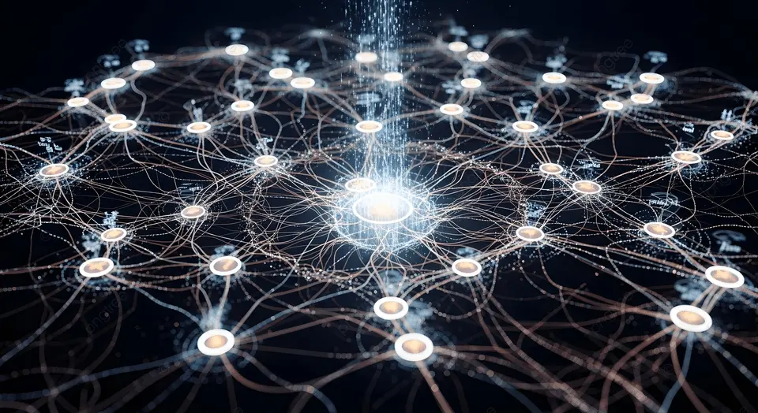
CHAPTER 03
How AI
Works
Si Funksionon IA
The Magic Behind the Machine
Magjia pas Makinës

Slide 12
03 / HOW AI WORKS
Machine Learning: Teaching Computers to Learn
Machine Learning: Mësimi i Kompjuterëve për të Mësuar
What is Machine Learning?
The Learning Process
Machine Learning (ML) enables computers to learn patterns from data without being explicitly programmed for every scenario.
1
Feed Data
ML mundëson kompjuterët të mësojnë modele nga të dhënat.
Jepni të dhëna
2
Train Model
Three Types of Machine Learning
Stërvitni modelin
1
Supervised Learning
3
Test & Evaluate
Testoni & Vlerësoni
Model learns from labeled data (input-output pairs). Like a student learning with an answer key.
Modeli mëson nga të dhëna të etikuara.
4
Deploy & Use
Përdorni
2
Unsupervised Learning
Model finds hidden patterns in unlabeled data. Like discovering groups in a crowd.
Modeli gjen modele të fshehura.
Simple Analogy
3
Think of ML like teaching a child to recognize animals—show many examples, and they learn to identify new ones!
Reinforcement Learning
Model learns through trial and error, receiving rewards or penalties. Like training a pet.
Modeli mëson përmes provës dhe gabimit.
Mendoni ML si mësimin e një fëmije për të njohur kafshët.

Slide 13
03 / HOW AI WORKS
Deep Learning & Neural Networks
Key Concepts
Deep Learning & Rrjetet Neuronale
🧠 Neurons
Processing units that receive, process, and transmit information
What is Deep Learning?
Deep Learning uses artificial neural networks with multiple layers to learn complex patterns from data—mimicking how the human brain works.
⚖️ Weights & Biases
Parameters that determine connection strength
Deep Learning përdor rrjete neuronale artificiale me shumë shtresa.
🔄 Activation Functions
Decide whether a neuron should be activated
How Neural Networks Work
📉 Loss Function
1
2
Measures how wrong the prediction is
Input Layer
Hidden Layers
Receives raw data (images, text, numbers) and passes it to the next layer.
Process information through multiple layers, extracting features and patterns.
Brain Analogy
3
Output Layer
4
Learning Process
Neural networks are inspired by the human brain's structure—billions of interconnected neurons working together!
Produces the final result (classification, prediction, decision).
Adjusts connections (weights) through forward and backward propagation.
Rrjetet neuronale janë të frymëzuara nga struktura e trurit njerëzor.

Slide 14
03 / HOW AI WORKS
Machine Learning vs Deep Learning
Machine Learning vs Deep Learning
AspectAspekti | Machine LearningMachine Learning | Deep LearningDeep Learning
DefinitionPërkufizimi | Algorithms that learn from data and improve with experience | Subset of ML using multi-layered neural networks
Data RequirementKërkesa për të Dhëna | Small to MediumHundreds to thousands of examples | Large DatasetsMillions of examples needed
Feature ExtractionEkstraktimi i Veçorive | Manual—experts must identify and select relevant features | Automatic—learns features directly from raw data
Training TimeKoha e Stërvitjes | FastSeconds to hours | SlowHours to days/weeks
Hardware NeedsNevojat Hardware | Can run on standard CPUs | Requires GPUs or TPUs for training
InterpretabilityInterpretueshmëria | EasyCan explain decisions | Difficult"Black box" problem
Best ForMë i MiRi Për | Structured data, smaller datasets, when interpretability matters | Unstructured data (images, text, audio), complex pattern recognition

Slide 15
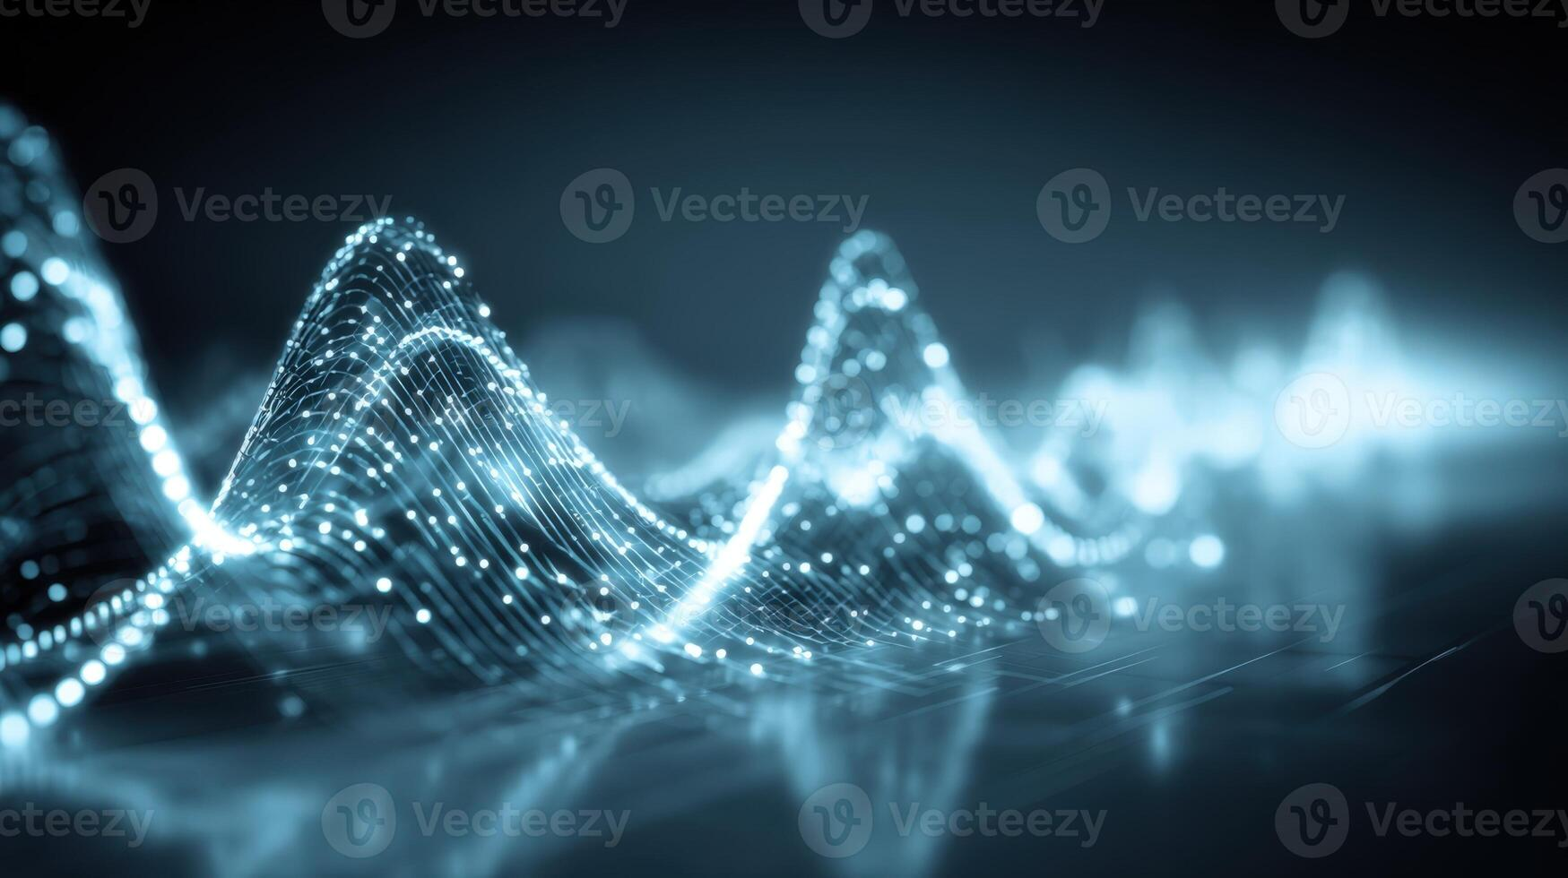
CHAPTER 04
Key AI
Technologies
Teknologjitë Kryesore të IA-së
The Building Blocks of Intelligence
Bllokët Ndërtues të Inteligjencës

Slide 16
04 / KEY TECHNOLOGIES
Natural Language Processing (NLP)
How NLP Works
Përpunimi i Gjuhës Natyrore (NLP)
1️⃣ Tokenization
Breaks text into words or phrases
What is NLP?
2️⃣ Part-of-Speech Tagging
NLP enables computers to understand, interpret, and generate human language. It bridges the gap between human communication and computer understanding.
Identifies grammatical roles
NLP mundëson kompjuterët të kuptojnë dhe gjenerojnë gjuhën njerëzore.
3️⃣ Parsing
Understands sentence structure
Core NLP Tasks
4️⃣ Semantic Analysis
Extracts meaning and intent
📝 Sentiment Analysis
🏷️ Named Entity Recognition
Determines emotional tone (positive, negative, neutral)
Identifies names, places, organizations
🌐 Machine Translation
💬 Chatbots & Assistants
Translates text between languages
Conversational AI systems
Real-World Impact
ChatGPT processes millions of conversations daily, helping users write, code, learn, and solve problems!
🎙️ Speech Recognition
📄 Text Summarization
Converts spoken language to text
Creates concise summaries of documents
ChatGPT përpunon miliona biseda çdo ditë!

Slide 17
04 / KEY TECHNOLOGIES
Computer Vision: Teaching Machines to See
Computer Vision: Mësimi i Makinave për të Parë
What is Computer Vision?
How It Works
Computer Vision enables AI to interpret and understand visual information from images and videos—just like human vision, but faster and more accurate.
1️⃣ Image Acquisition
Computer Vision mundëson IA të interpretojë informacionin vizual.
Captures image or video
2️⃣ Preprocessing
Key Applications
Enhances and normalizes
3️⃣ Feature Extraction
Facial Recognition
Autonomous Vehicles
Identifies edges, shapes, textures
Unlocks phones, identifies people in photos, security systems
Detects pedestrians, traffic signs, lane markings, obstacles
4️⃣ Classification/Detection
Medical Imaging
Quality Control
Recognizes objects and patterns
Detects tumors, fractures, diseases in X-rays, MRIs, CT scans
Inspects products for defects in manufacturing
Incredible Accuracy
Modern computer vision systems can recognize objects with over 99% accuracy—often better than humans!
Sistemet moderne njohin objektet me mbi 99% saktësi!

Slide 18
04 / KEY TECHNOLOGIES
Robotics & Automation
Robotika & Automatizimi
Manufacturing & Industrial
Healthcare & Medical
🏭 Smart Factories
🔬 Surgical Robots
AI optimizes production lines, reduces waste, improves efficiency
Enable precise minimally invasive surgeries
🦾 Robotic Arms
👩‍⚕️ Assistive Robots
Perform precise assembly, welding, painting tasks
Support elderly care, rehabilitation therapies
🤖 Autonomous Mobile Robots
💊 Medication Delivery
Navigate warehouses, transport materials
Automated dispensing and delivery systems
Examples: Tesla, Siemens, FANUC
Examples: da Vinci, Toyota HSR
Agriculture & Food Tech
🚁 Agricultural Drones
Monitor crop health, detect diseases, optimize irrigation
The Power of AI Robotics
🍎 Robotic Harvesters
AI-powered robots combine physical capabilities with intelligent decision-making, transforming industries worldwide.
Pick fruits and vegetables with precision
📦 Food Processing
By 2026: 40% of enterprises will use AI agents
Automated sorting, packaging, quality control
Deri në 2026: 40% e ndërmarrjeve do të përdorin agjentë IA
Examples: Blue River, Iron Ox

Slide 19
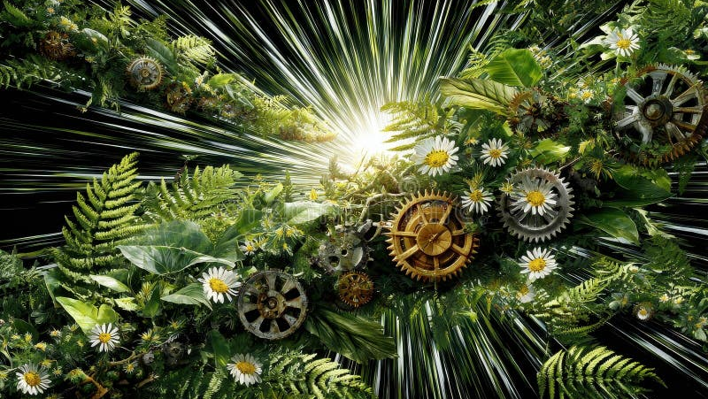
CHAPTER 05
AI in
Action
IA në Veprim
Real-World Applications Transforming Industries
Aplikime Reale që Transformojnë Industritë

Slide 20
05 / AI IN ACTION
AI in Healthcare: Saving Lives
IA në Shëndetësi: Duke Shpëtuar Jetë
Revolutionizing Healthcare
Remarkable Growth
AI is transforming how we diagnose, treat, and prevent diseases. From analyzing medical images to predicting patient outcomes, AI augments healthcare professionals' capabilities.
6
IA po transformon mënyrën se si diagnostikojmë dhe trajtojmë sëmundjet.
FDA-authorized AI devices in 2015
Diagnostic Assistance
Treatment Planning
AI analyzes medical images to detect tumors, fractures, and abnormalities with high accuracy.
Personalized care recommendations based on patient data, genetics, and treatment history.
1,250+
Asistencë diagnostikuese me saktësi të lartë.
Planifikim i personalizuar i trajtimit.
FDA-authorized AI devices today
Drug Discovery
Administrative Automation
Real Example
Accelerates identification of promising drug candidates, reducing development time from years to months.
Streamlines paperwork, appointment scheduling, and insurance verification.
Mayo Clinic's AI platform analyzes brain scans to detect dementia patterns earlier and more precisely than human eyes alone!
Zbulimi i ilaçeve përshpejtohet.
Automatizimi administrativ lehtëson punën.
Platforma e Mayo Clinic zbulon demencën më herët.

Slide 21
05 / AI IN ACTION
AI in Education: Personalized Learning
IA në Arsim: Mësimi i Personalizuar
Transforming Education
Key Benefits
AI creates personalized learning experiences tailored to each student's needs, pace, and learning style—making education more effective and engaging.
📈 Effectiveness
AI krijon përvoja mësimore të personalizuara.
Increases personalization and engagement
⚡ Efficiency
Personalized Learning Paths
Intelligent Tutoring
Reduces teacher workload
AI adapts content difficulty and pace based on individual student performance and understanding.
AI tutors provide immediate feedback, explanations, and practice problems tailored to each student.
🎯 Equity
Shtigje mësimore të personalizuara.
Tutorë inteligjentë ofrojnë ndihmë të menjëhershme.
Supports all learners
⏰ Immediate Feedback
Students learn faster
Automated Grading
Accessibility Tools
Popular Examples
AI grades assignments, essays, and tests instantly—freeing teachers to focus on instruction.
Translation, captioning, text-to-speech, and adaptive interfaces help students with disabilities.
Duolingo
Language learning with AI
Vlerësimi i automatizuar lehtëson punën e mësuesve.
Mjetet e aksesueshmërisë ndihmojnë të gjithë studentët.
Khan Academy
Adaptive learning paths
Coursera
Personalized course recommendations

Slide 22
05 / AI IN ACTION
AI in Finance: Smarter Banking
IA në Financë: Banka më e Zgjuar
Transforming Finance
Impact Statistics
AI is revolutionizing how financial institutions operate, from fraud detection to customer service—making banking faster, safer, and more personalized.
30%
AI po revolucionarizon mënyrën se si operojnë institucionet financiare.
Reduction in operational costs
Fraud Detection
Algorithmic Trading
40%
AI analyzes transactions in real-time with 95%+ accuracy, reducing false positives by 70%.
AI executes trades in milliseconds based on market patterns—eliminating emotional decisions.
Faster fraud detection savings
Zbulimi i mashtrimit me saktësi mbi 95%.
Tregtimi algoritmik ekzekuton transaksione në milisekonda.
$202B
Global AI funding in 2025
Credit Scoring
Customer Service
Uses alternative data (rent, utilities, mobile usage) for more inclusive lending decisions.
AI chatbots provide 24/7 support, answer questions, and resolve issues instantly.
Did You Know?
Vlerësimi i kredisë përdor të dhëna alternative.
Chatbotët ofrojnë mbështetje 24/7.
AI processes millions of transactions per second worldwide—detecting fraud faster than any human could!
AI përpunon miliona transaksione në sekondë!

Slide 23
05 / AI IN ACTION
Famous AI Systems You Should Know
Sisteme të Famshme IA që Duhet të Njihni
ChatGPT / GPT-4
DALL-E / Midjourney
AlphaGo / AlphaZero
Conversational AI that understands and generates human-like text—used for writing, coding, learning, and problem-solving.
Image generation AI creates stunning artwork from text descriptions—revolutionizing creative industries.
Game-playing AI defeated world champions at Go and chess—demonstrating strategic thinking beyond human capability.
Impact: 100M+ users in 2 months
Impact: Transformed digital art
Impact: Breakthrough in strategy AI
IBM Watson
Tesla Autopilot
Siri / Alexa
Question-answering AI won Jeopardy! and now assists in healthcare, finance, and customer service.
Self-driving AI enables vehicles to navigate roads, detect obstacles, and make driving decisions.
Voice assistants understand spoken commands, answer questions, and control smart home devices.
Impact: Pioneered practical AI
Impact: Leading autonomous driving
Impact: Billions of daily interactions
These AI systems are already transforming how we live, work, and create!

Slide 24

CHAPTER 06
Benefits &
Challenges
Përfitimet & Sfida
The Double-Edged Sword of AI
Shpata me Dy Presa e IA-së

Slide 25
06 / BENEFITS & CHALLENGES
Benefits of AI for Society
Përfitimet e IA-së për Shoqërinë
Increased Efficiency
Improved Accuracy
24/7 Availability
AI automates repetitive tasks, processes data faster, and operates 24/7 without fatigue.
AI reduces human error in diagnosis, data analysis, and decision-making processes.
AI systems work around the clock, providing instant service without breaks or downtime.
Impact: 30-40% productivity gains
Impact: 95%+ accuracy in many tasks
Impact: Always-on customer support
Handling Dangerous Tasks
Democratizing Expertise
Accelerating Research
AI performs hazardous work in mining, disaster response, and toxic environments.
AI makes expert knowledge accessible to everyone—legal advice, medical info, education.
AI speeds up scientific discovery in medicine, climate science, and materials research.
Impact: Saves human lives
Impact: Reduces knowledge gaps
Impact: Years of work in months
Economic Impact: AI will contribute $15.7 trillion to the global economy by 2030
Ndikimi Ekonomik: IA do të kontribuojë 15.7 trilion dollarë në ekonominë globale deri në 2030

Slide 26
06 / BENEFITS & CHALLENGES
Challenges & Ethical Concerns
Sfidat & Shqetësimet Etike
Job Displacement
Lack of Transparency
AI automation may eliminate some jobs, requiring workforce retraining and adaptation.
Deep learning models are "black boxes"—hard to understand how they make decisions.
Automatizimi mund të eliminojë disa vende pune.
Modelet e deep learning janë "kuti të zeza".
Algorithmic Bias
Over-Reliance on AI
AI systems can inherit and amplify biases from training data, leading to unfair outcomes.
Excessive dependence on AI may erode human skills and critical thinking abilities.
Sistemet IA mund të trashëgojnë paragjykime.
Varësia e tepërt nga IA mund të erodojë aftësitë njerëzore.
Privacy Concerns
Environmental Impact
AI requires vast amounts of data, raising questions about surveillance and data protection.
Training large AI models consumes significant energy, contributing to carbon emissions.
Stërvitja e modeleve të mëdha konsumon energji.
IA kërkon sasi të mëdha të dhënash.
Security Risks
AI systems can be vulnerable to attacks, manipulation, and adversarial inputs.
The Path Forward
Sistemet IA mund të jenë të cenueshme ndaj sulmeve.
Addressing these challenges requires ethical AI development, transparent algorithms, robust regulations, and human oversight.
AI should augment, not replace, human judgment
IA duhet të zgjerojë, jo të zëvendësojë, gjykimin njerëzor

Slide 27
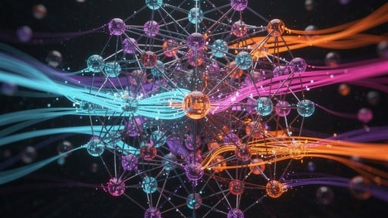
CHAPTER 07
The Future
of AI
E Ardhmja e IA-së
What Lies Ahead
Çfarë na Pret

Slide 28
07 / THE FUTURE OF AI
AI Trends & Predictions for 2026 and Beyond
Trendet & Parashikimet e IA-së për 2026 dhe Përtej
Agentic AI
Strengthened AI Governance
Autonomous AI agents will perform complex tasks with minimal human supervision—planning, reasoning, and adapting in real-time.
Ethical frameworks and regulations will become mandatory—ensuring transparency, accountability, and fairness in AI systems.
Agjentët autonomë IA do të kryejnë detyra komplekse.
Kornizat etike do të bëhen të detyrueshme.
Prediction: 40% of enterprises will use AI agents by 2026
Prediction: 80% of regulated industries will require AI audits
Small Language Models (SLMs)
Hyper-Personalization
Efficient, compact AI models will run on devices, reducing costs and enabling edge computing with less energy consumption.
AI will deliver tailored experiences at scale—customizing education, healthcare, marketing, and entertainment for each individual.
Modele kompakte IA do të funksionojnë në pajisje.
IA do të ofrojë përvoja të personalizuara.
Prediction: SLMs will handle 60% of business AI tasks
Prediction: 20-30% uplift in engagement metrics
AI-Robotics Convergence
AGI Timeline Predictions
Physical AI will enable robots with human-like dexterity and intelligence—transforming manufacturing, healthcare, and logistics.
DeepMind (Shane Legg)
50% by 2028
IA fizike do të mundësojë robotë me aftësi njerëzore.
Anthropic (Dario Amodei)
By 2027
Prediction: 25% productivity boost in physical labor sectors
Ray Kurzweil
By 2029
OpenAI (Sam Altman)
By 2035

Slide 29
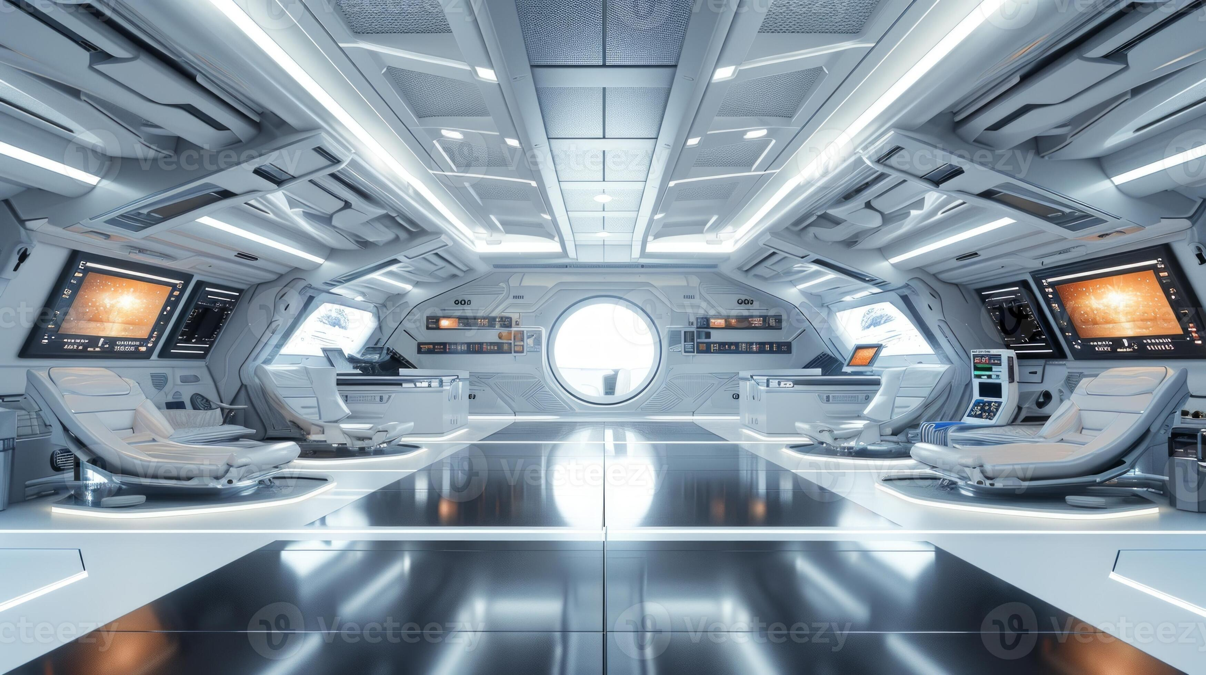
The Journey
Continues
Udhëtimi Vazhdon
AI is not just the future—it's the present. The question is not whether AI will change our world, but how we will shape that change.
IA nuk është vetëm e ardhmja—është e tashmja. Pyetja nuk është nëse IA do të ndryshojë botën tonë, por si ne do ta formësojmë atë ndryshim.
The future belongs to those who learn to work alongside AI, amplifying human creativity and potential.
E ardhmja i përket atyre që mësojnë të punojnë krahas IA-së, duke zgjeruar kreativitetin dhe potencialin njerëzor.
Learn / Mëso
Adapt / Adaptohu
Create / Krijo

